Slide 1
Cost Concepts

Slide 2
Opportunity Cost
Opportunity cost is the cost of a good or service as measured by the alternative uses that are foregone by producing the good or service.
  If 15 bicycles could be produced with the materials used to produce an automobile, the opportunity cost of the automobile is 15 bicycles.
The price of a good or service often may reflect its opportunity cost.

Slide 3
Short Run versus Long Run
Short Run
  A time period when at least one input, such as plant size, cannot be changed
  Plant Size
    The physical size of the factories that a firm owns and operates to produce its output

Slide 4
Short Run versus Long Run
Long Run
  The time period in which all factors of production can be varied

Slide 5
Short Run versus Long Run
Managers take account of both the short-run and long-run consequences of their behavior.
While making decisions about what
to do today, tomorrow, and next week—they keep an eye on the long-run benefits.

Slide 6
The Relationship Between Output and Inputs
A firm takes numerous inputs, combines them using a technological production process and ends up with output.
We classify production inputs in two broad categories—labor and capital.

Slide 7
The Relationship Between Output and Inputs
Production
  Any activity that results in the conversion of resources into products that can be used in consumption

Slide 8
The Relationship Between Output and Inputs
Average Physical Product
  Total product divided by the variable input

Slide 9
The Relationship Between Output and Inputs
Marginal Physical Product
  The physical output that is due to the addition of one more unit of a variable factor of production
  The change in total product occurring when a variable input is increased and all other inputs are held constant
  Also called marginal product

Slide 10
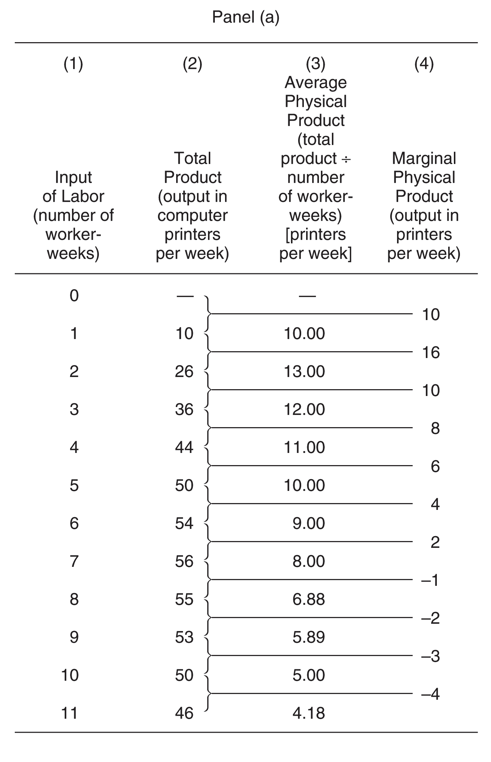
The Production
Function and Marginal Product:
A Hypothetical Case, Panel (a)

Slide 11
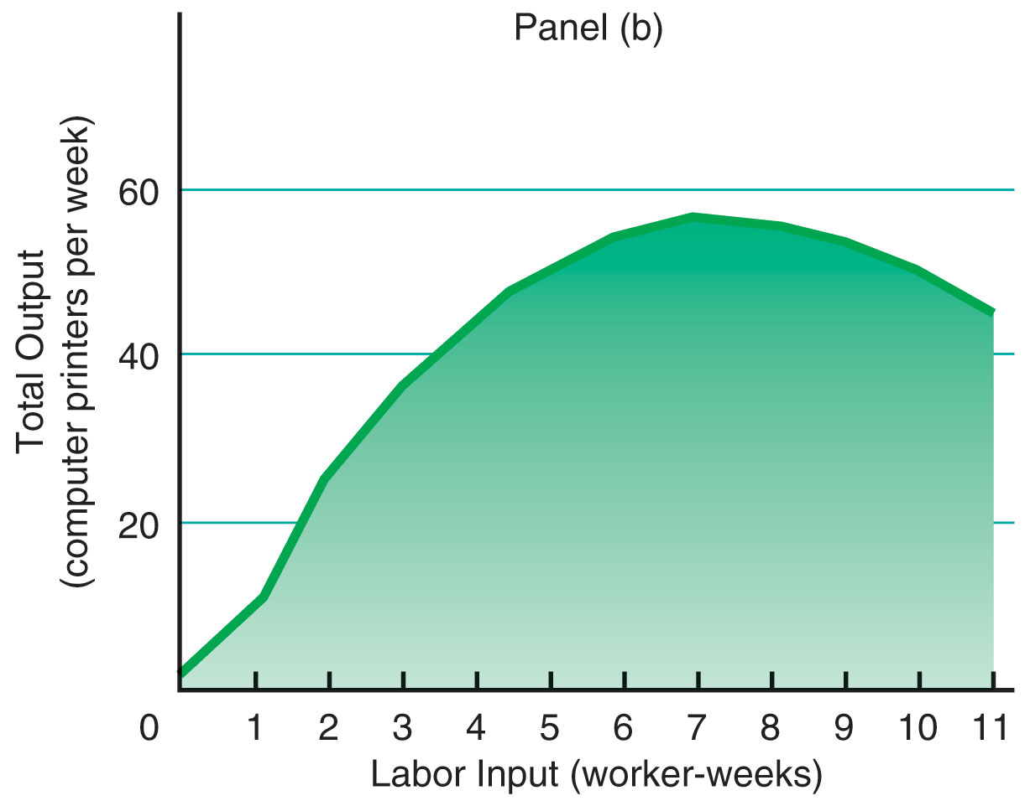
The Production
Function and Marginal Product:
A Hypothetical Case

Slide 12
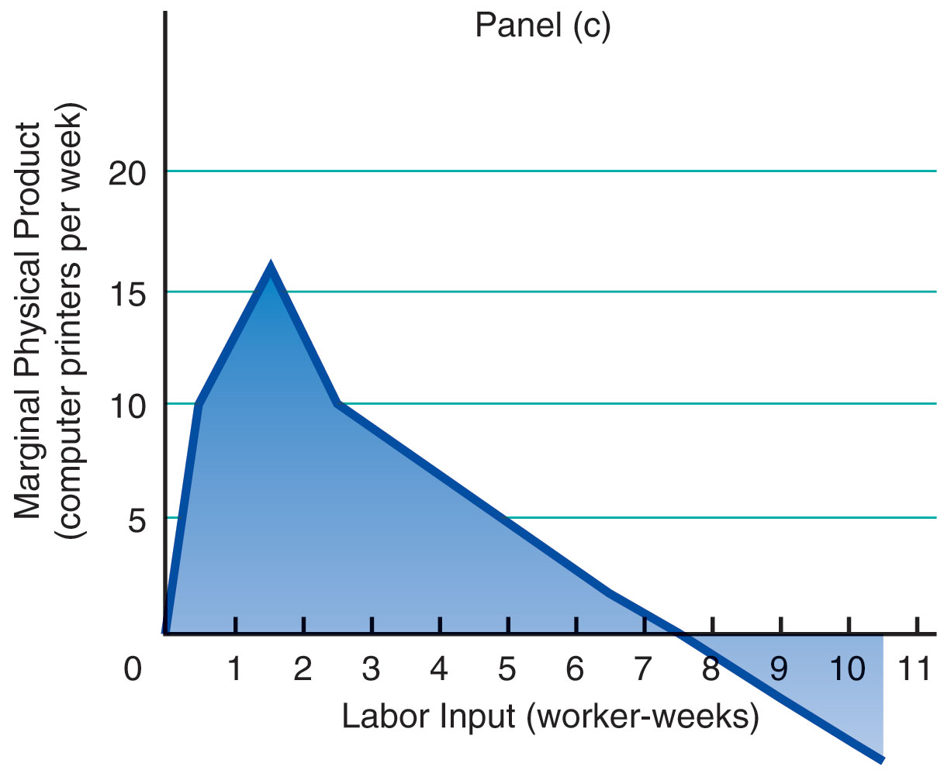
The Production
Function and Marginal Product:
A Hypothetical Case

Slide 13
Diminishing Marginal
Product
Law of Diminishing Marginal Product
  The observation that after some point, successive equal-sized increases in a variable factor of production, such as labor, added to fixed factors of production, will result in smaller increases in output

Slide 14
Short-Run Costs to the Firm
Total Costs
  The sum of total fixed costs and total
  variable costs
Fixed Costs
  Costs that do not vary with output
Variable Costs
  Costs that vary with the rate of production
Total costs (TC) = TFC + TVC

Slide 15
Short-Run Costs to the Firm
Average Total Costs (ATC)
Total costs (TC)
Average total costs (ATC) =
Output (Q)

Slide 16
Short-Run Costs to the Firm
Average Variable Costs (AVC)
Total variable costs (TVC)
Average variable costs (AVC) =
Output (Q)

Slide 17
Short-Run Costs to the Firm
Average Fixed Costs (AFC)
Total fixed costs (TFC)
Average fixed costs (AFC) =
Output (Q)

Slide 18
Short-Run Costs to the Firm
Marginal Cost
  The change in total costs due to a one-unit change in production rate
Change in total cost
Marginal costs (MC) =
Change in output

Slide 19
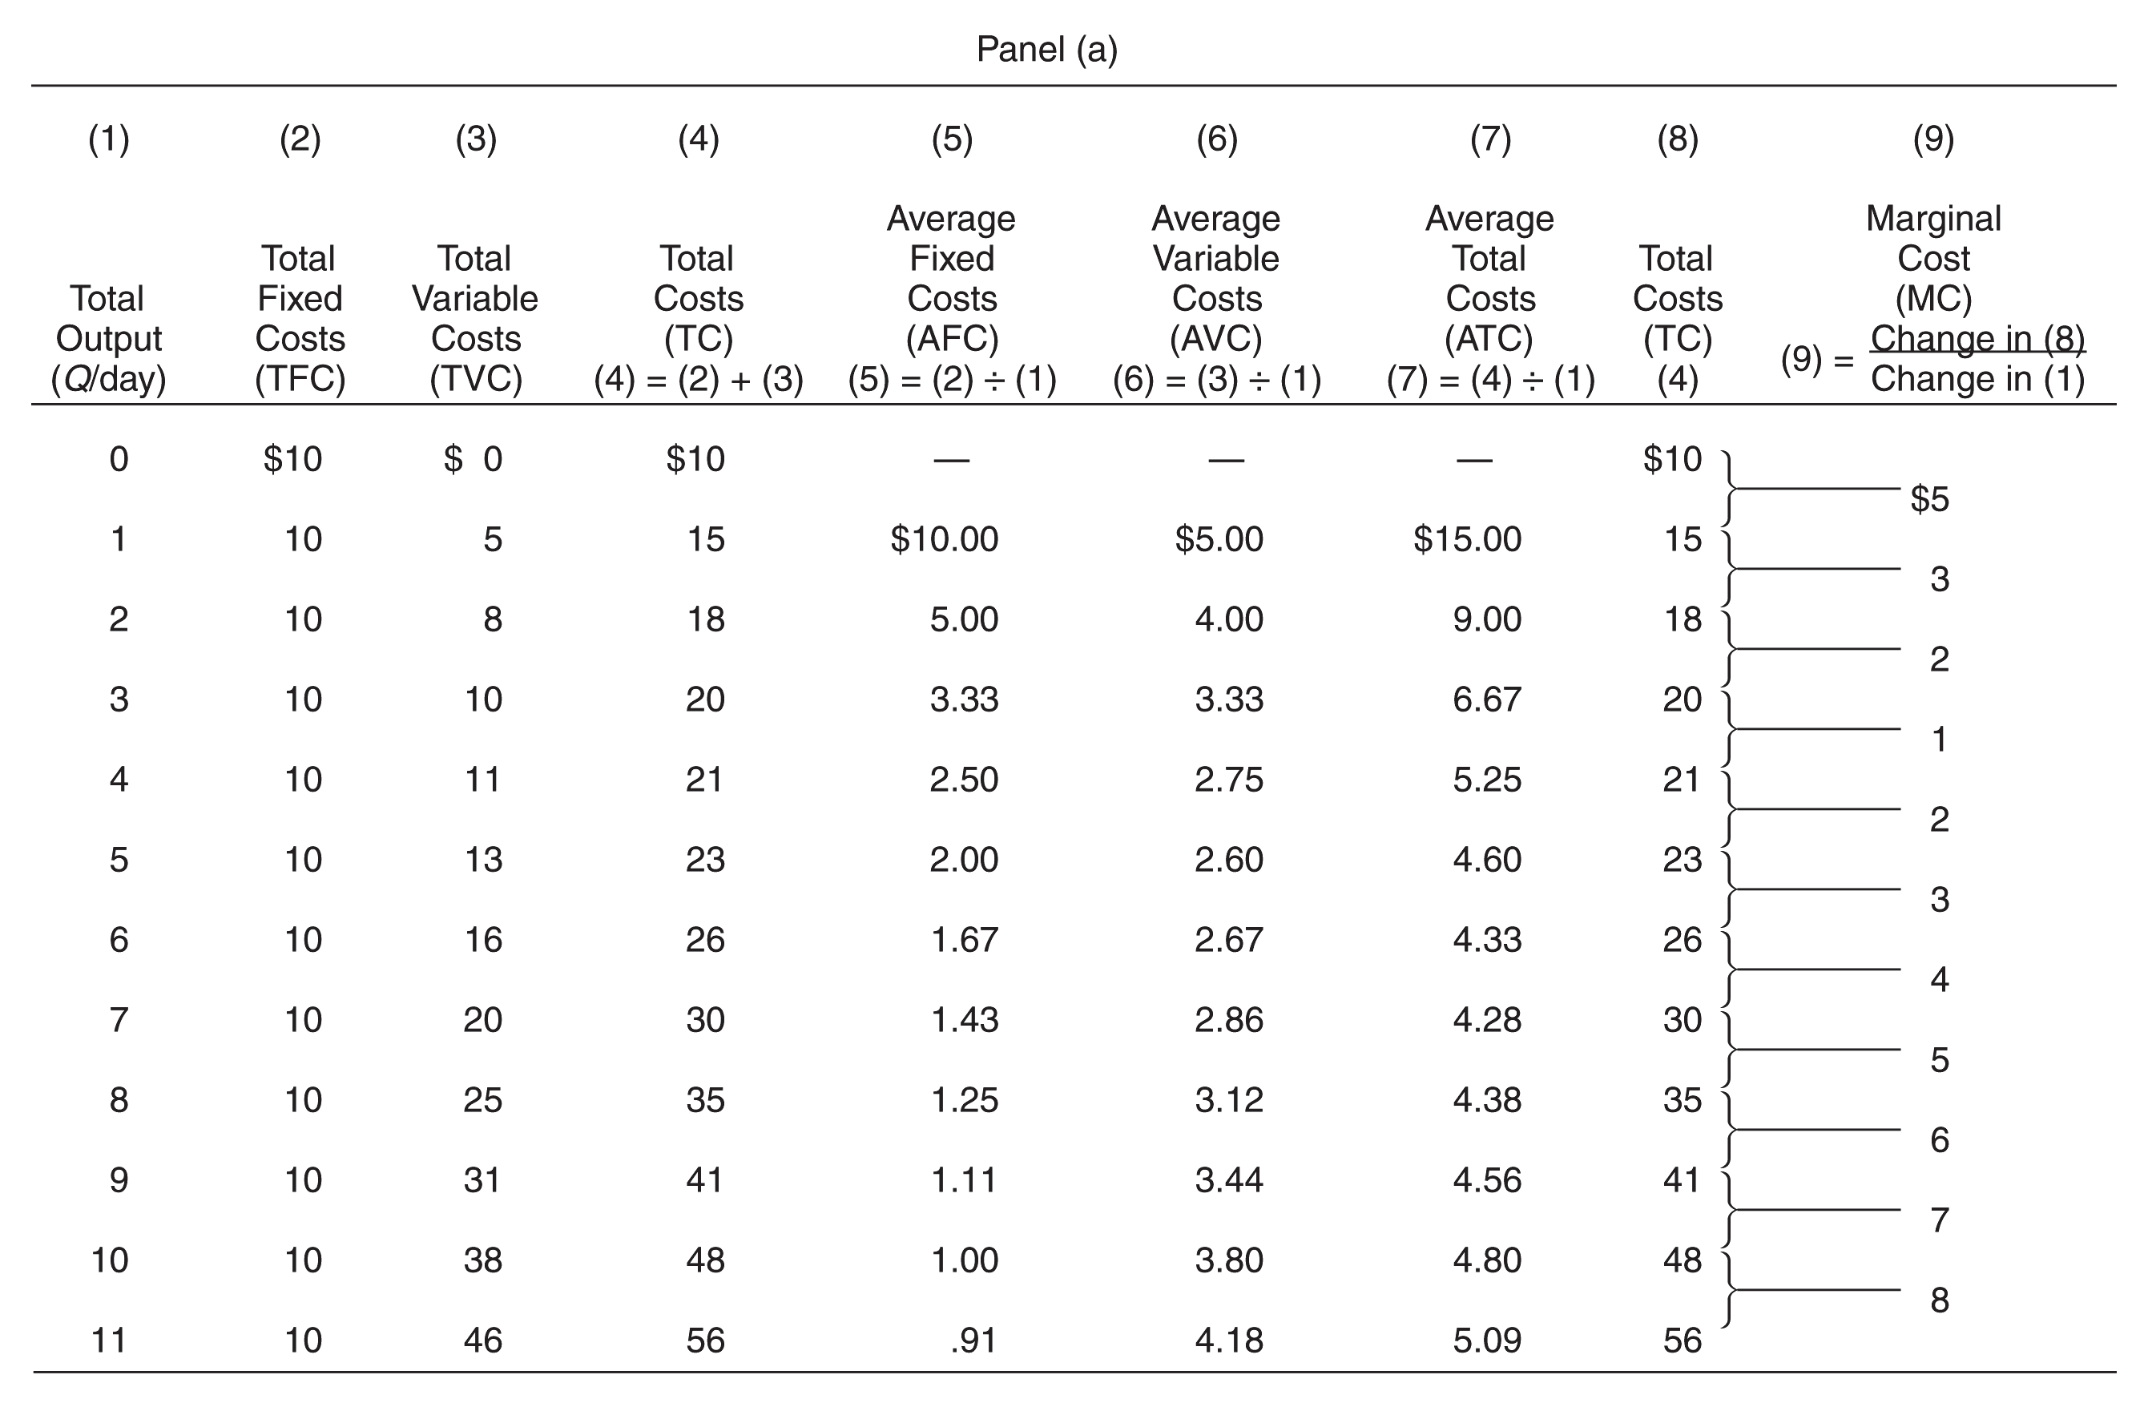
Cost of Production: An Example

Slide 20
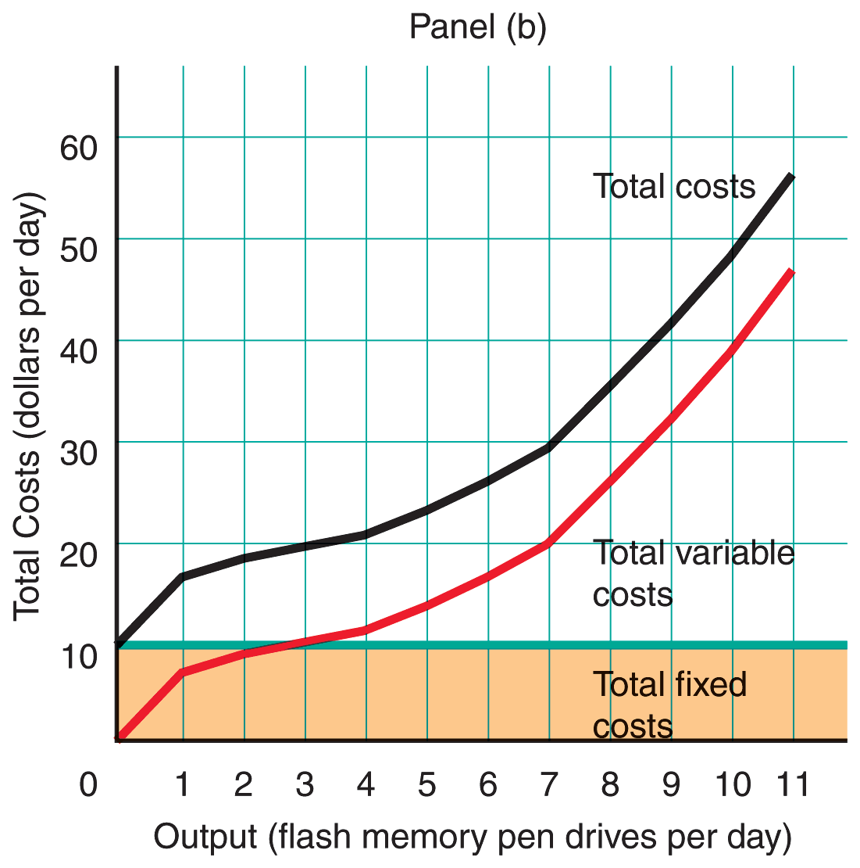
Cost of Production: An Example

Slide 21
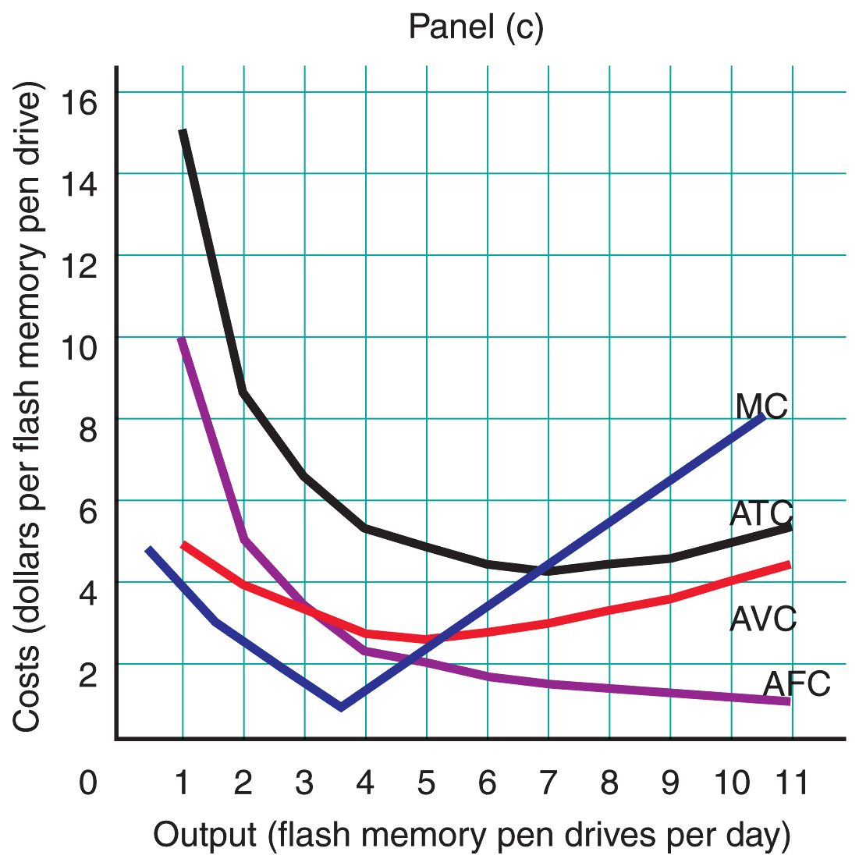
Cost of Production: An Example

Slide 22
Short-Run Costs to the Firm
Question
  What do you think—is there a predictable relationship between the production function and AVC, ATC, and MC?

Slide 23
Short-Run Costs to the Firm
Answer
  As long as marginal physical product rises, marginal cost will fall, and when marginal physical product starts to fall (after reaching the point of diminishing marginal product), marginal cost will begin to rise.

Slide 24
The Relationship Between Average and Marginal Costs
When marginal costs are less than average variable costs, the latter must fall.
When marginal costs are greater than average variable costs, the latter must rise.

Slide 25
The Relationship Between Average and Marginal Costs
There is also a relationship between marginal costs and average total costs.
  Average total cost is equal to total cost divided by the number of units produced.
  Marginal cost is the change in total
  cost due to a one-unit change in the production rate.

Slide 26
The Relationship Between Diminishing Marginal Product and Cost Curves
Firms’ short-run cost curves are a reflection of the law of diminishing marginal product.
Given any constant price of the variable input, marginal costs decline as long as the marginal product of the variable resource is rising.

Slide 27
The Relationship Between Diminishing Marginal Product and Cost Curves
At the point at which diminishing marginal product begins, marginal costs begin to rise as the marginal product of the variable input begins to decline.

Slide 28
The Relationship Between Diminishing Marginal Product and Cost Curves
If the wage rate is constant, then the labor cost associated with each additional unit of output will decline as long as the marginal physical product of labor increases.

Slide 29
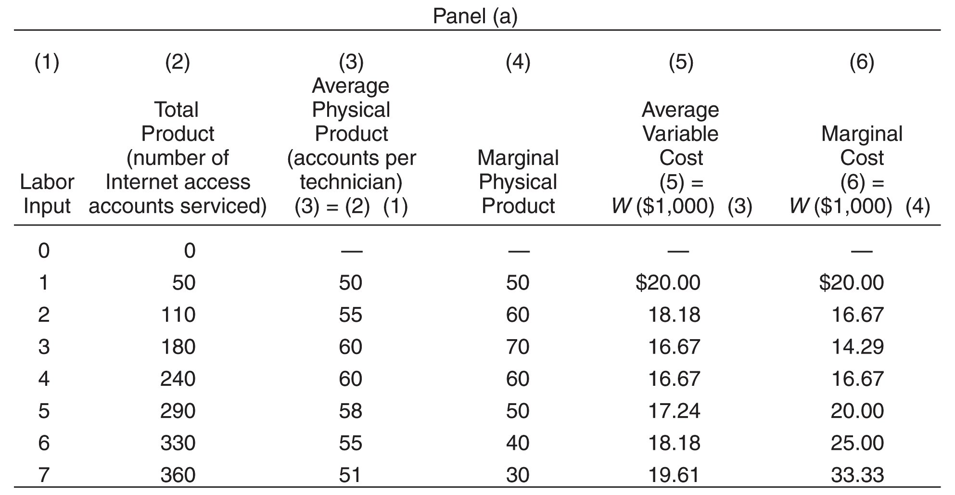
The Relationship Between Output and Costs
/
/
/

Slide 30
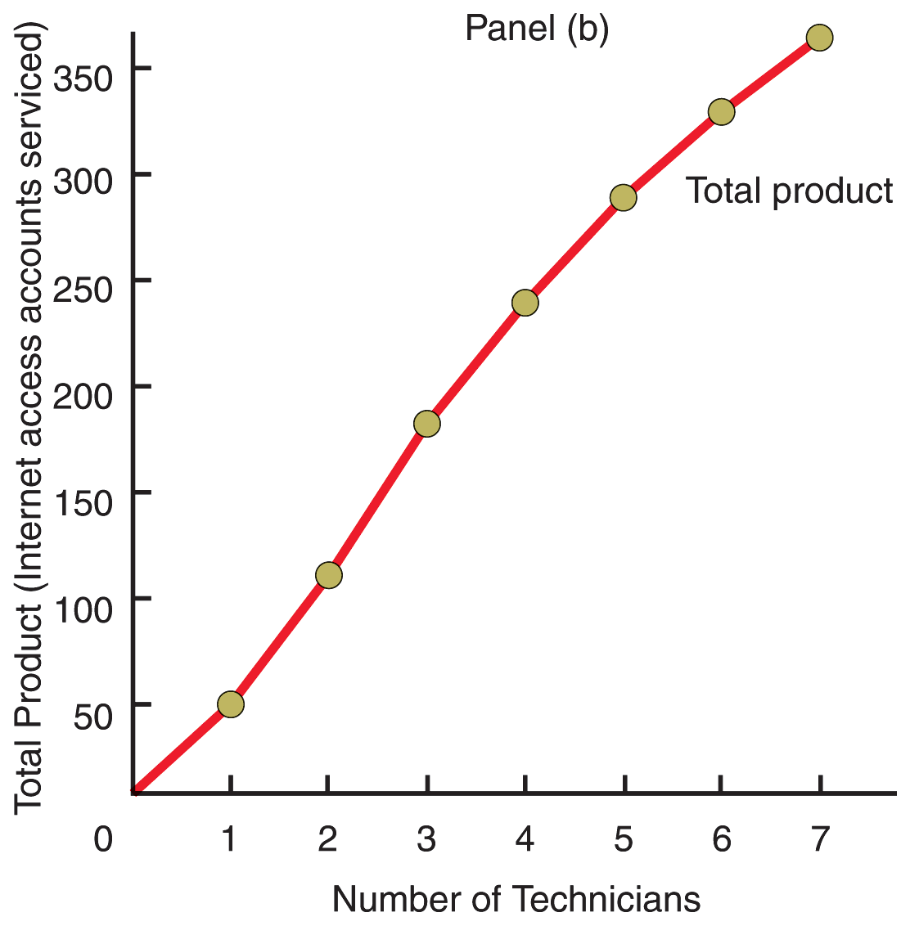
The Relationship Between Output and Costs

Slide 31
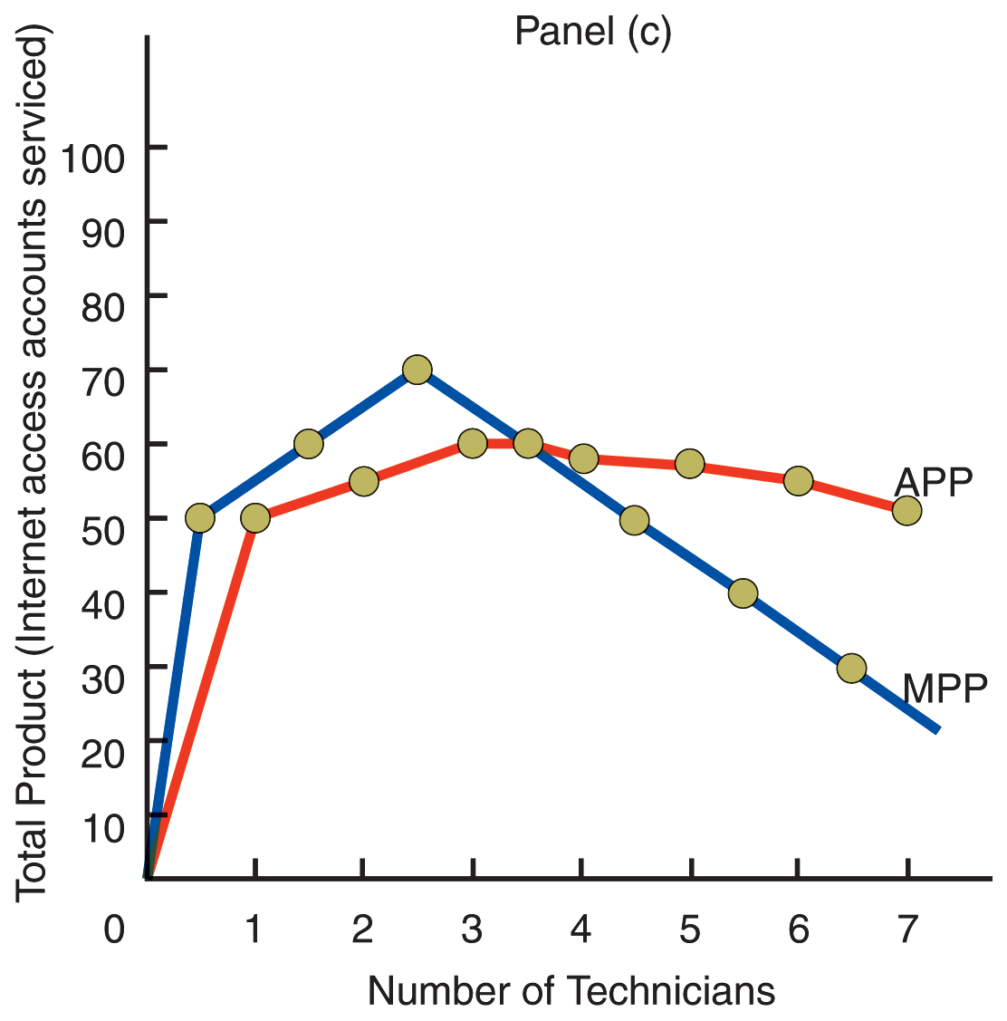
The Relationship Between Output and Costs

Slide 32
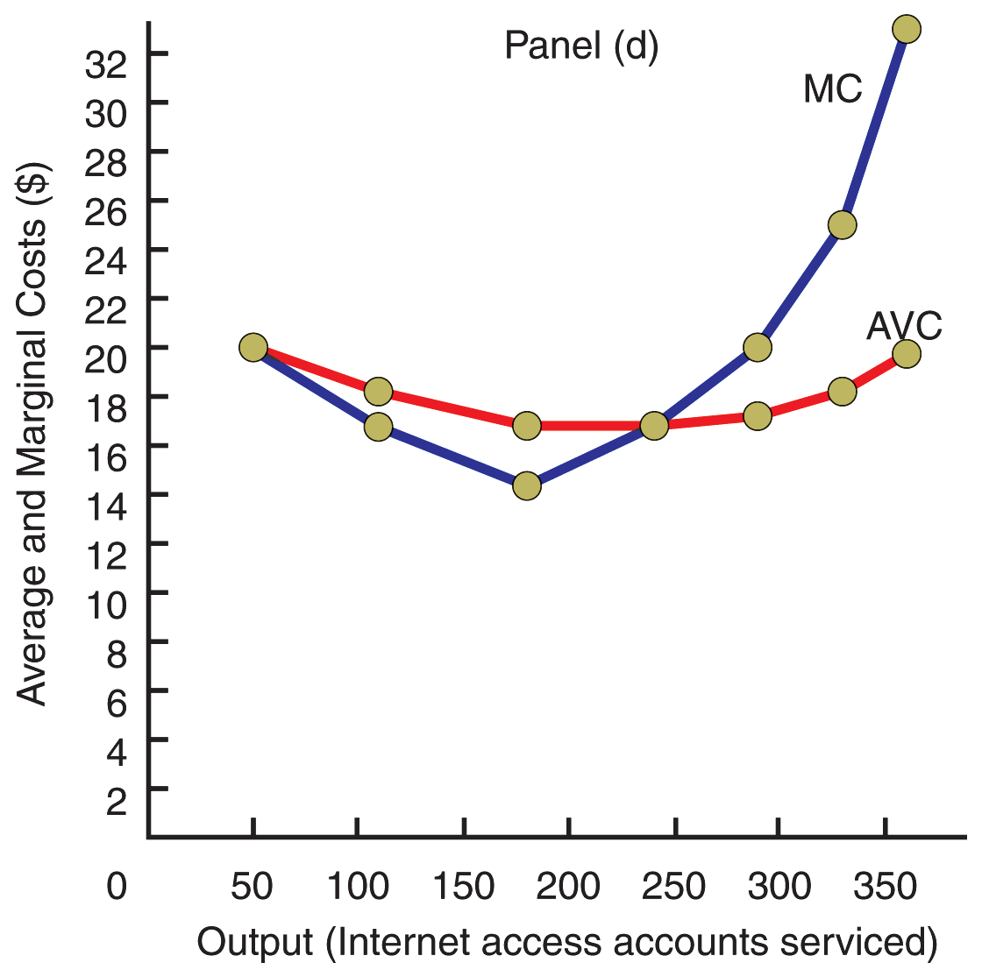
The Relationship Between Output and Costs

Slide 33
Long-Run Cost Curves
Planning Horizon
  The long run, during which all inputs
  are variable

Slide 34
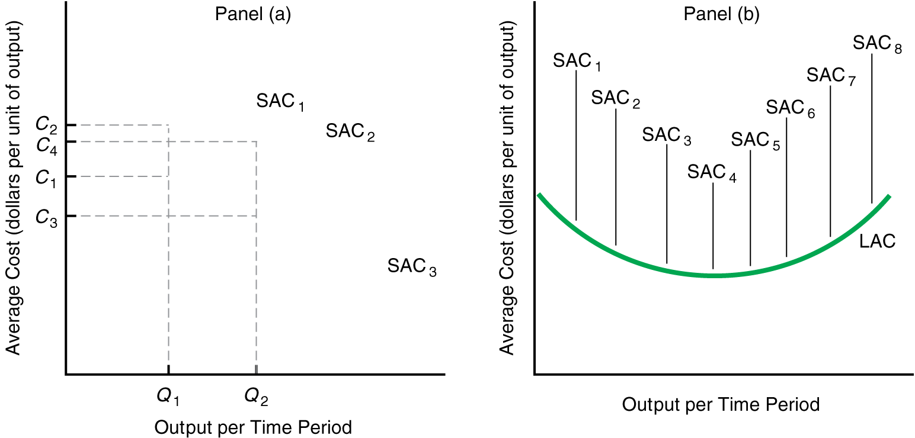











Preferable Plant Size and the Long-Run Average Cost Curve

Slide 35
Long-Run Cost Curves
Long-Run Average Cost Curve
  The locus of points representing the minimum unit cost of producing any given rate of output, given current technology and resource prices

Slide 36
Long-Run Cost Curves
Observation
  Only at minimum long-run average cost curve is short-run average cost curve tangent to long-run average cost curve.
Question
  Why do you think the long-run average cost curve is U-shaped?

Slide 37
Why the Long-Run Average Cost Curve is U-Shaped
Economies of scale
Constant returns to scale
Diseconomies of scale

Slide 38
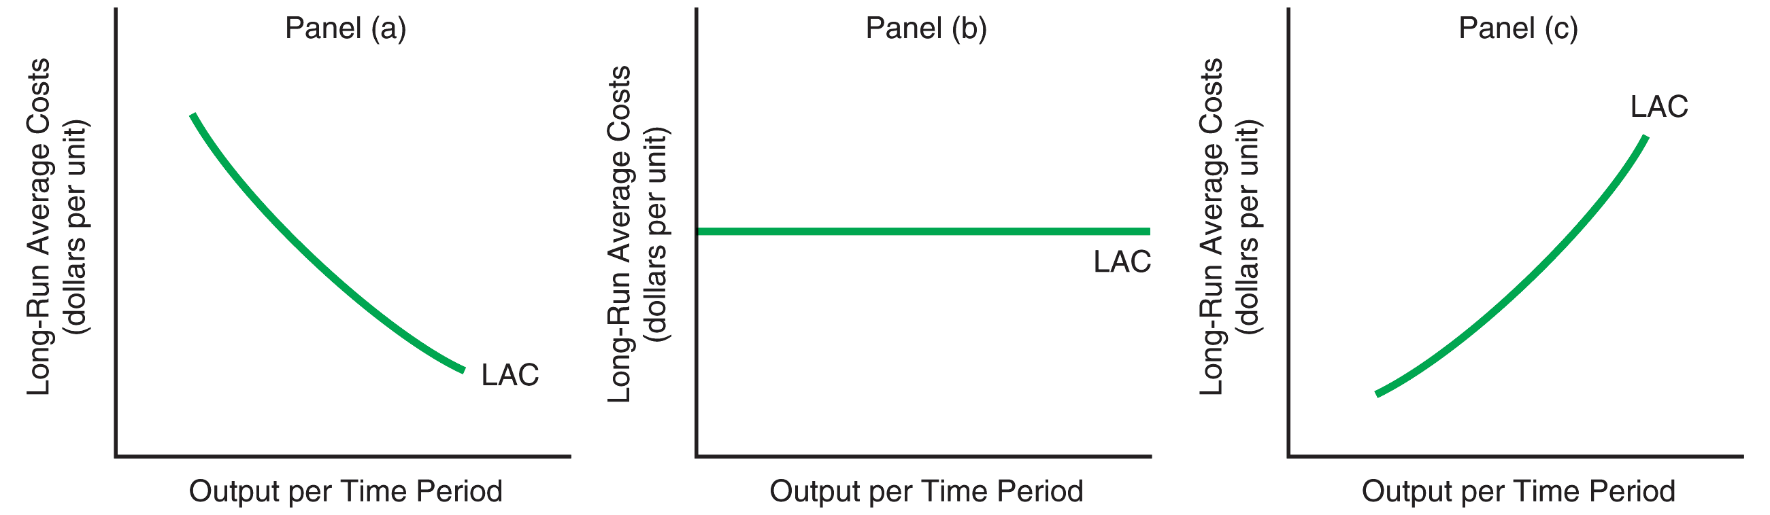
Economies of Scale, Constant Returns to Scale, and Diseconomies of Scale Shown with Long-Run Average Cost Curve

Slide 39
Why the Long-Run Average Cost Curve is U-Shaped
Economies of Scale
  Decreases in long-run average costs resulting from increases in output
    These economies of scale do not persist indefinitely, however.
    Once long-run average costs rise, the curve begins to slope upwards.

Slide 40
Why the Long-Run Average Cost Curve is U-Shaped
Reasons for economies of scale
  Specialization
    Division of tasks or operations
  Dimensional factor
  Improved productive equipment

Slide 41
Why the Long-Run Average Cost Curve is U-Shaped
Explaining diseconomies of scale
  Limits to the efficient functioning
  of management
  Coordination and communication is more of a challenge as firm size increases

Slide 42
Summary Discussion of Learning Objectives
The short run versus the long run from a firm’s perspective
  Short run—a period in which at least one input is fixed
  Long run—a period in which all inputs
  are variable

Slide 43
Summary Discussion of Learning Objectives
The law of diminishing marginal product
  As more units of a variable input are employed with a fixed input, marginal physical product eventually begins to decline.
A firm’s short-run cost curves
  Fixed and average fixed cost
  Variable and average variable cost
  Total and average total cost
  Marginal cost

Slide 44
Summary Discussion of Learning Objectives
A firm’s long-run cost curve
  Planning horizon
  All inputs are variable including plant size

